Slide 1
Zaid Ahmed Khan
Anirvan Krishna
Soumojit Bhattacharya
SSVKSS Jyothiraditya
TEAM
STREAMLINE
IIT Kharagpur

Slide 2
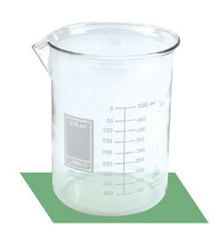
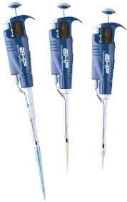
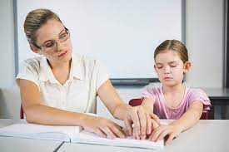
2
Problem Statement & Existing Protocols
Accessible lab equipment for the visually impaired:
Application/Device to know the height of the filled liquid in a test tube or beaker
Existing Solutions:
Human Assistant
High precision pipettes

Slide 3
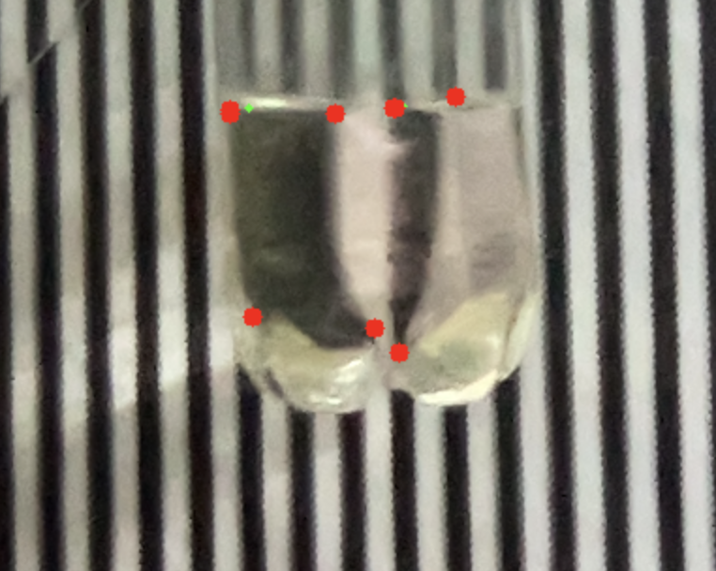
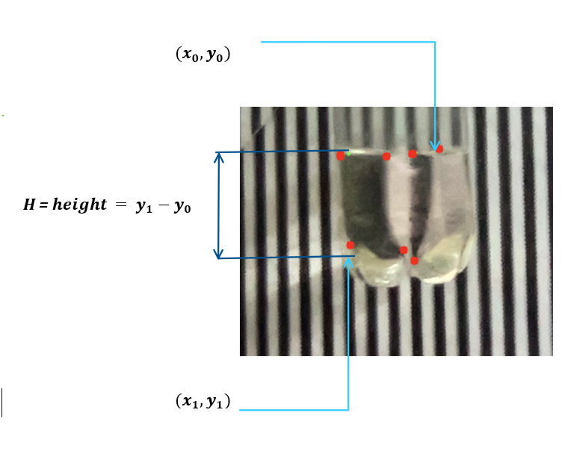
3
Our Solution
Using Image Processing to determine the liquid height
Image Processing Model
Hey, the volume I measured is...
Web App with Model Deployed

Slide 4
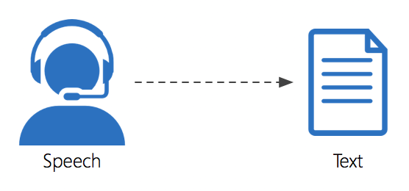
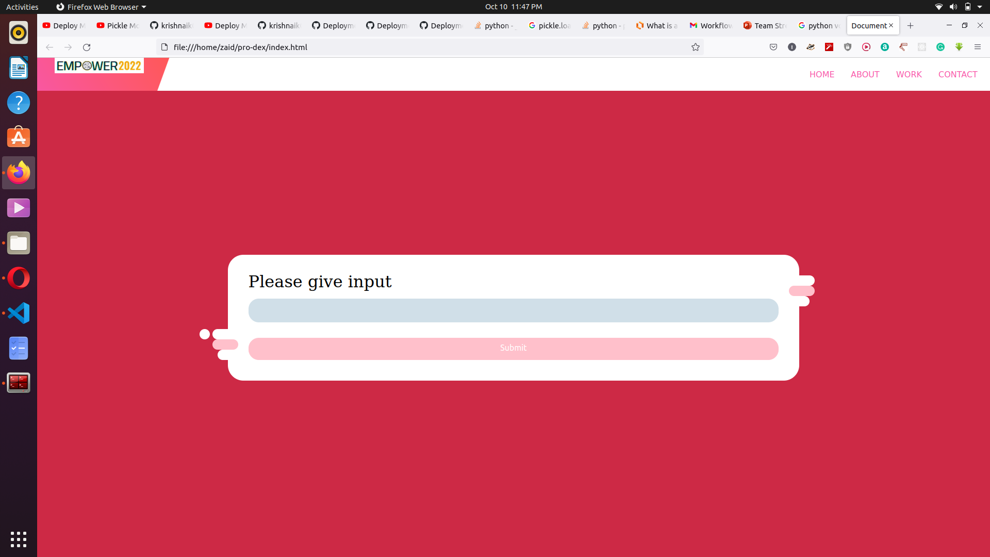
4
Workflow
Convert Image to binary image using brightness of pixel using OpenCV
Get contours from binary image
Approximate contours to appropriate polynomials and get vertices
Use these vertices get heights of water and top of container
Coverting text output to voice format and telling the user.
Taking input from user through web interface made from HTML, CSS, JavaScript, API, Flask .
Converting voice input to text format using Python.

Slide 5
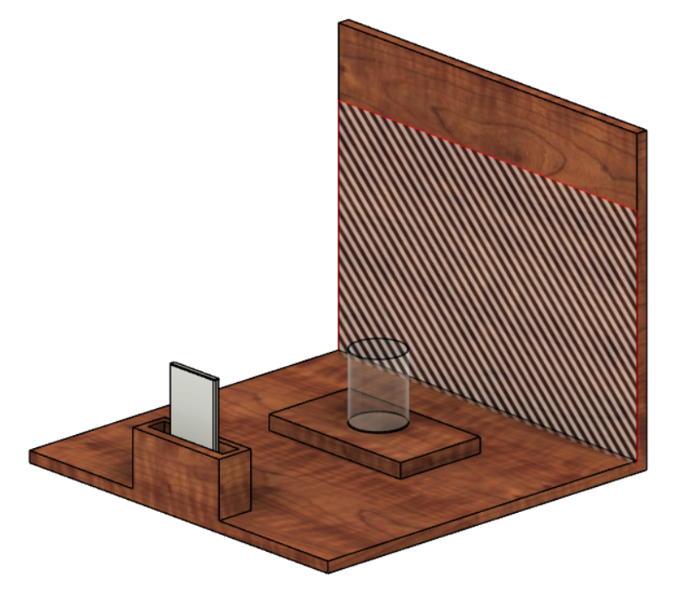
5
Benefits and Scope of Improvement
Beaker and Mobile Stand with the desired background
Benefits:
Affordable and avoids any unnecessary costs
Limited hardware requirement so increases portability
Can be easily accessed through a smartphone
Scope of Improvement:
One more camera can be fit which can measure the diameter of the beaker
Model can be further improvised to detect titrations and color changes
Beaker
Mobile with our webapp open
Mobile stand for the user

